Slide 1



Easy backends for mobile apps
Bruno Carrier
brunopierrecarrier@gmail.com

Slide 2
Why a backend talk at Mobile Warsaw?
How the Stepstone Native Applications team came to use backend developers
Human skills may be available, but hard to assign to a project
Native apps have to be more than a mobile spinoff
Native apps use patterns do not resemble desktop browsers’
Native apps’ lifecycle differs from desktop browsers’
Mobile devices capacities are different from desktops’

Slide 3
Your takeaways from this talk
Understanding of some backend capacities
Understanding of mechanisms involved
Understanding of the impact and requirements of changes you may ask backend teams
Enough knowledge to get started and implement solutions yourself
Source code used tonight

Slide 4
Agenda
Introducing servers and Spring
Open RESTful server
User-restricted RESTful server
Cloud computing and scaling
Databases – migrating from mobile to backend
Hibernate
Securing your server
Development tools
Continuous integration
Avoiding pitfalls

Slide 5
Cloud solutions and scaling

Slide 6

How to scale
Scale up: add more capacity to a machine
Scale out: add more machines to your system

Slide 7
Why scale?
Respond to increases in traffic
Meet customer demands
Deliver constant service quality
Respond to decreases in traffic
Reduce costs

Slide 8
Cloud options
Platform as a Service (Paas)
We help you set specific applications on our hardware
Infrastructure as a Service (Iaas)
We lend you our hardware. Do what you want with it.

Slide 9

Cloud options
 | Platform as a Service | Infrastructure as a Service
Availability | Very high | Very high
AWS Examples | DynamoDB, RDS, Elasticache | EC2
Use for | Hard to scale components | Easily scalable components
Best used when | Components don’t differentiate your product | Components differentiate your product
Disaster recovery | Generally recovers easily | Good luck if instances are stateful

Slide 10
Why cloud solutions?
Reduce labor costs
Reduce project overhead
Flexibility in planning and scaling
No more mysterious arcane devops
Instant solutions
Risk mitigation through flexible computing output – no fast growth curse
High availability
The line between proof of concept, development and live environments is very, very thin
You can find developers who are fluent in your cloud provider
Cheaper, better disaster recovery – will you replace a failing machine on Saturday night?
Do you want to work on hardware or on software?

Slide 11

Introducing servers and Spring

Slide 12
How do RESTful servers work?

Slide 13
What Spring boot provides for free
Servlet container configuration (Tomcat)
Serialization / deserialization
Dependency versions compatible with each other
Web.xml logic
Security
Metrics, health check (Spring boot Actuator)

Slide 14
What Spring boot provides with minimal efforts
Security (Spring security)
Metrics, health check (Spring boot Actuator)
Integration with social networks (Spring Social, Spring Facebook, Spring Twitter, LinkedIn)
Integration with most popular data stores (SQL, Cassandra, Couchbase, Neo4j, MongoDB, Redis, ElasticSearch, Solr, Gemfire, Aerospike, Hadoop)
Spring OAuth (Efforts are more than minimal ☺ )
Message queues (Spring AMQP)
Worker servers

Slide 15
With Spring, what do you need to do?
Controllers
Database(s)
Request handling

Slide 16
Spring Boot philosophy
Stand-alone, production-grade Spring based Applications
You can “just run it”
Opinionated view of the Spring platform and third-party libraries
Get started with minimum fuss.
Most Spring Boot applications need very little Spring configuration
And if you need to configure anything, you can!

Slide 17
Demo
Simple endpoints
Elastic Beanstalk deployment

Slide 18
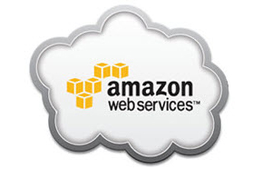
AWS
Base components

Slide 19
Deployment flow
Upload using Beanstalk
Store .jar on S3
Beanstalk deploys .jar on EC2 instance

Slide 20
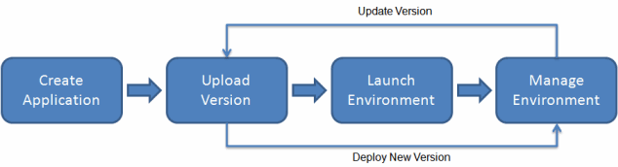


Elastic Beanstalk

Slide 21

S3 – Simple Storage Service
You can think of it as a giant hard drive
It is partitioned by buckets
Access to buckets can be private or public

Slide 22
EC2 – Elastic Compute Cloud
They are (virtual) machines on which your applications run
Under the hood, other services use EC2 instances
You can deploy an application to an EC2 instance
You can deploy a pre-defined AMI (Amazon Machine Image) to an EC2 instance

Slide 23
RDS – Relational Database Service
RDS instances are traditional SQL databases
They can scale up reasonably well
They can scale out well with read-only copies

Slide 24
IAM – Identity and Access Management
Create user accounts for the AWS console
Create access keys to allow your application to use specific AWS features
Give access only to what is necessary. No more.
Granulate the rights you give to different users. If your application stores pictures on S3, does it need to access the bucket containing your .jar files?

Slide 25
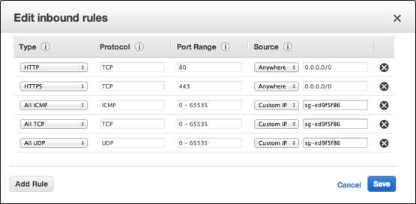
Security groups
Security groups are like firewalls
You may allow traffic from:
IPs
IP ranges
Entities from your AWS cloud

Slide 26
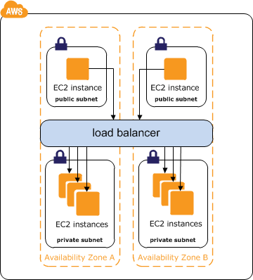
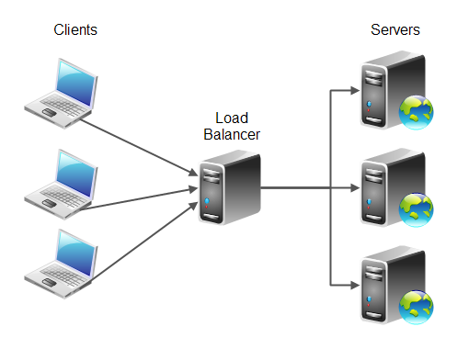
Load balancer
This is the component that allows you to scale out
Typical balancing strategy: round-robin (algorytm karuzelowy)

Slide 27
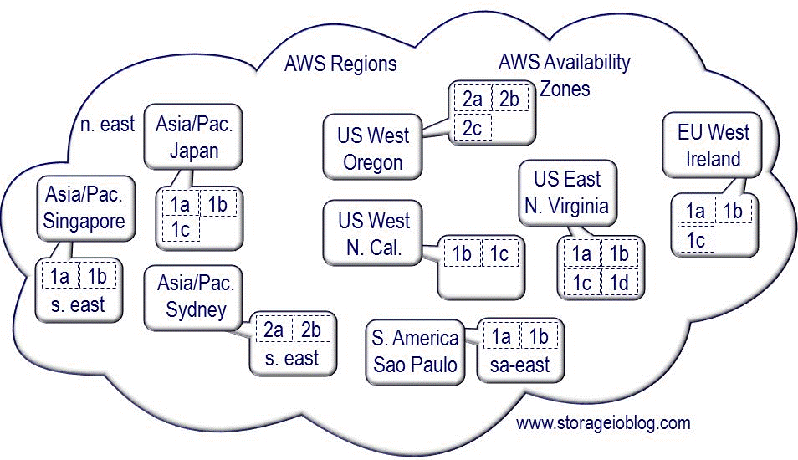
Localization
Regions (EU West Ireland)
Availability zones (1a, 1b, 1c)

Slide 28
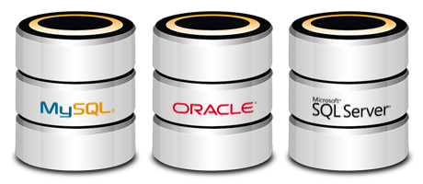
Persisting data
JPA and Hibernate

Slide 29
Database - From Android to the backend
Android apps use ORMs
Backends also use ORMs
A traditional Java backend will persist data using:
JPA – Java Persistency Api
Indicates which class must be persisted
Indicates the role and relationship of objects within a class
ORM – Object Relational Mapper
Executes the architecture indicated by JPA

Slide 30
Java Persistency Api
Class:
@Entity
Optional: @Table(name=“piwa”)
Primary key:
@Id
Optional: @Generated

Slide 31
Hibernate
Pros
Technically simple
Does a LOT of heavy lifting for you
Maintainable
Free
You won’t hear about it at meetings
Almost all Java developers know Hibernate
Cons
Indexing might not be optimal
Relationships between columns can be hard to establish for complex cases
Remember, don’t optimize without measuring!
Additional information:
http://www.javacodegeeks.com/2011/09/problems-with-orms.html

Slide 32
Hibernate - Portable SQL querying language
HQL – Hibernate Query Language
Pros: You can change SQL databases without modifying you queries
Cons: Might not be optimized
Technology-specific SQL (MySQL, MS-SQL, PostgreSQL, etc.)
Pros: Write queries in their native language
Cons: Ties code to a specific vendor

Slide 33
Demo
JPA + Hibernate
Storing actual data

Slide 34

Sharing components with your Android app

Slide 35

Save time
Model classes
Endpoint integration tests
Server-side, usually RestAssured or RestTemplate
You can use Retrofit to test on the server-side and have your networking component ready for your Android app

Slide 36


Securing your server
Spring security - Accounts and permissions

Slide 37


What is security?
How secure is a bottle of beer?
Is it resistant to malicious Mallory?
Is it safe in my hands?
Is it safe in my baby’s hands?
Is it safe in your hands?
No risk, no fun
System protection: keeping bad people out, welcoming in good people
Risk can be mitigated, not eliminated
System features are open doors you need to protect

Slide 38
Injecting user credentials into your controller logic
Simply add an Authentication object to your method signature to gain access to the authentication object
This allows you to:
Verify the user is the owner of an object
Verify the user has roles/scope required to interact with an object
Provide user-specific info (e.g. profile) based on their account
Associate a data insert with the user’s ID
Much, much more

Slide 39
Code presentation
In-memory authentication process
SQL-store authentication process
Authentication injection
Using the principal inside your business logic

Slide 40

Securing your server
Injection attacks

Slide 41
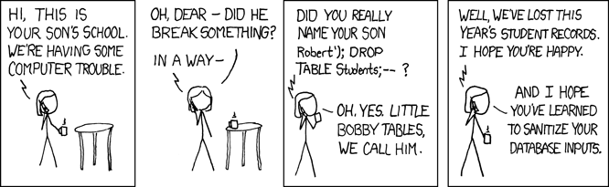
SQL Injections (XKCD)
https://www.explainxkcd.com/wiki/index.php/327:_Exploits_of_a_Mom

Slide 42
Defending against SQL injection attacks
Named Parameters should always be used
It sanitizes parameters passed to the query.
Pure HQL / SQL queries are fine if they take no inputs other than what you wrote yourself
String concatenation / building is the devil.

Slide 43
Defending against SQL injection attacks
(Unsafe) example:
List results = session.createQuery ("from Orders where customerName= " + nameProvidedByClient) .list();
(Safe) example:
Query hqlQuery = session.createQuery(" from Orders where customerName= :name ");
hqlQuery.setString("name", name)
List results = hqlQuery.list();
Injection attacks - Additional readings
http://software-security.sans.org/developer-how-to/fix-sql-injection-in-java-hibernate
http://www.tutorialspoint.com/hibernate/hibernate_query_language.htm
https://www.owasp.org/index.php/SQL_Injection_Prevention_Cheat_Sheet

Slide 44

Development tools

Slide 45
Development tools - IDE
IntelliJ IDEA
Pros
Extremely similar to Android Studio
Community (Free) version is excellent
Cons
Full version is very expensive
Eclipse
Pros
Full version is free
Lots of convenience 3rd-party packages (AWS, Spring boot)
Cons
Inferior to IntelliJ IDEA

Slide 46
Database Management (SQL)
MySQL
MySQL Workbench
HeidiSQL
MS SQL
HeidiSQL
Microsoft SQL Server Management Studio Express
PostgreSQL
pgAdmin
HeidiSQL

Slide 47
API requests
Postman

Slide 48

Continuous Integration

Slide 49
How to deploy
Manual steps
maven clean
maven package
upload to beanstalk
Maven plugins can deploy to beanstalk for you from the command line
If not a maven plugin, then many tools can do it
Boxfuse
Chef
Puppet
Atlassian suite, Bamboo, AWS plug-ins
Etc.

Slide 50
Make .jar not .war
We’re in 2015 (who cares if your application is 40mb?)
You most likely want to deploy one application per container
Fat .jars are more portable
They do not depend on a particular web server container that they deploy to

Slide 51

How does AWS compare against other providers?

Slide 52
Cloud services compared
Project risks | AWS | Azure | MBaaS
Changing requirements | Flexible | Flexible | Inflexible model
Lack of technical capacity | Standard | Standard | Not a standard
Lack of executive support | Sexy among executives | Microsoft has a strong reputation
Cost | Free tier, reasonable fees | Free tier, reasonable fees | Can be quite expensive
Bad architectural choices | Wide choice of setups and offer | Wide choice of setups and offer | MBaaS decides for you

Slide 53
Cloud services compared
Project risks | AWS | Azure | MBaaS
Speed to market | Fast | Fast | Fastest
Integration between system components | Wide choice of machine/tech setups | Wide choice of machine setups | Limited offer
Disasters | Rather easy recovery | Rather easy recovery | ?
Devops | A charm to deploy to | ? | ?
Poor service provider quality | Good history of delivering | Good history of delivering | Some MBaaS backed by credible firms
Legal data privacy requirements | Can choose where to host data | Can choose where to host data | ?
http://www.tomsitpro.com/articles/azure-vs-aws-cloud-comparison,2-870.html
http://cloudacademy.com/blog/public-cloud-war-aws-vs-azure-vs-google/

Slide 54
Summarizing the comparison
How much time do you want to spend on your backend?
Once your project is up and running, do you want to continue developing it, or do you want to hand it off to someone else?
Do you plan on having your product grow?
How much operational risk can you tolerate?
What budget do you have for developing your project?
What budget do you have once your project is up and running?

Slide 55

Avoiding pitfalls

Slide 56
Avoid pitfalls
DO follow the maven clean > package approach for creating your jar file
A lot of plugins are maven-exclusive. Use the path of least resistance and use Maven instead of Gradle
KISS, YAGNI, DRY
Keep it simple stupid
You ain’t gonna need it
Don’t repeat yourself

Slide 57


Questions?
Thank you

Slide 58

Final word
I can provide:
Spring boot training
Architectural counselling
Backend architecture
Cloud system architecture
Talks at your company events
https://github.com/BrunoCarrier/SpringMobileWarsaw
brunopierrecarrier@gmail.com
Stepstone is looking for mobile developers!

